Slide 1
Why Easy Onborder?
° Is an application that has as purpose to ease the integration of newcomers in .msg.
° All the information is centralized and easy to access.
° Managers can keep track of the new employees and their needs before they come to work.
° Employees can keep up with the events in the company

Slide 2
New employees – check list with all the things to be done before the new employees arrival
Users in department – easy way to keep track of all employees in a specific department
Add/Remove users – each new employee will receive an account that will be deleted in the event that he leaves the company
Easy Onboarder
User Management
View Events – all events taking place within .msg are centralized so that any employee can enroll
Add event - this functionality supports the increase of the number of technical and non-technical seminars in msg
Events
View tutorials – new employees can go through tutorials and can understand the company's procedures much faster
Add tutorial – tutorials can be added directly or as draft; in the case of draft tutorials one or more users can work on the same tutorial
Tutorials
Easy Onboarder preview

Slide 3
Leiter
EoB
Employee
Mate
Stabileste data inceperii activitatii cu noul angajat
Creeaza
User-ul in
aplicatie
Parcurge si implementeaza Checklist-ul
Poate asigna tutoriale
Aproba tutoriale
Aproba event-uri
Cu 1 saptamana inainte trimite mail-ul informatiile legate de prima zi
Dupa 3 luni sterge Checklist-urile Leiter-ului si Buddy-ului
Dupa 3 luni muta angajatul din “New Employee” in “Departament”
Sterge user-ul cand pleca cineva
Primeste mail-ul cu datele legate de prima zi
Isi schimba parola la prima logare
Se poate inscribe la un event
Poate adauga tutoriale
Parcurge tutorialele din App
Poate crea un event
Este de-accord sa fie Mate
Il intampina pe noul angajat in prima zi
Parcurge si implementeaza Checklist-ul
Mate ii arata aplicatia

Slide 4
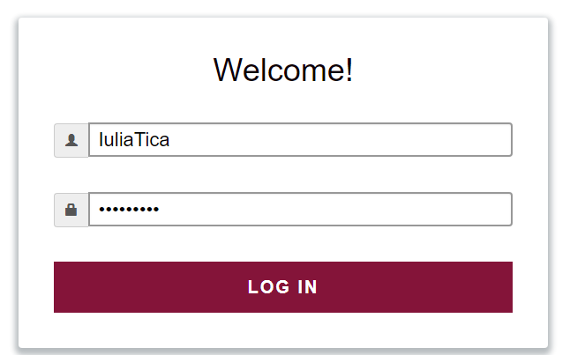
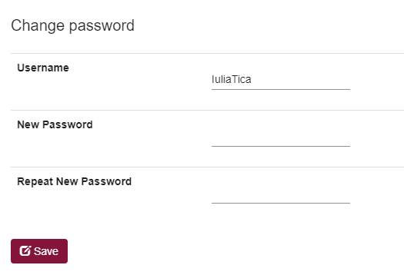
User login and logout
login
At the first login, the user is showed a popup in order to change the password.

Slide 5
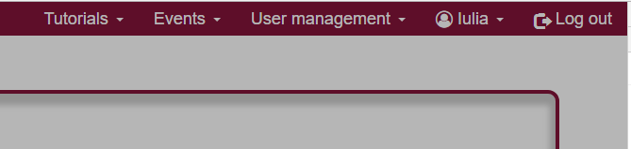
User login and logout
logout
The user can logout by pressing the Log out button in the menu bar

Slide 6
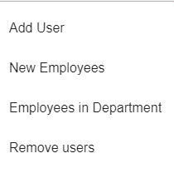
User management
Why user management?
Is an organized way to keep track of all the employees in .msg Systems.
A user account can be added or deleted.
User management provides a way to see all the new employees in the company
A list of all the users in the department of the currently logged person is shown.

Slide 7
User management
Adding a new user
In order to add a new user, provide the required information
First and Last names, the .msg and personal Emails, location, role and starting date are mandatory
Team, floor of the office, project department and mate are optional and can be added later
Possible roles: admin, employee, leiter, mate, human resources, content manager.

Slide 8
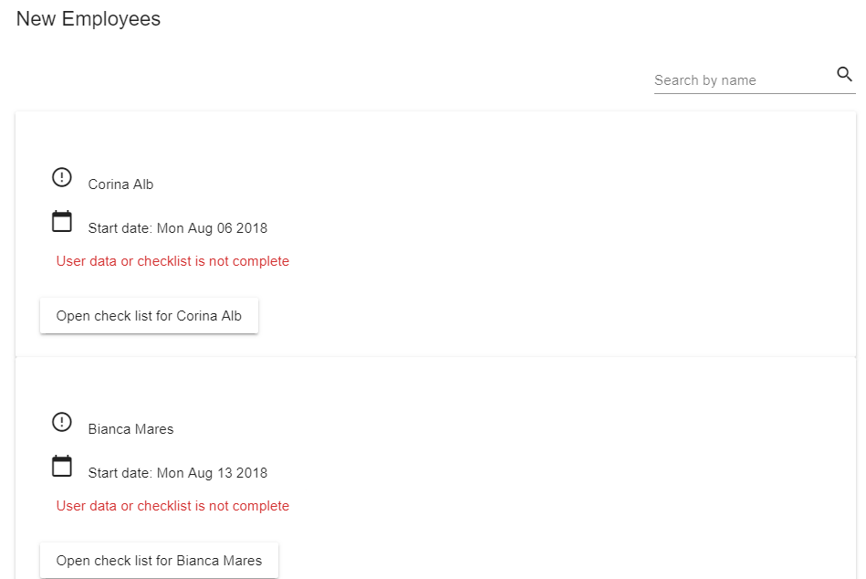
User management
New employees
The user can see a list with all the employees that will come in the near future.

Slide 9
User management
New employees (2)
The user can perform a search by name
The user can still update the information of the employee
Each user has a checklist attached that is meant to ease the work of the manager; the manager can easily keep track of the things that need to be done before the first day of the employee

Slide 10
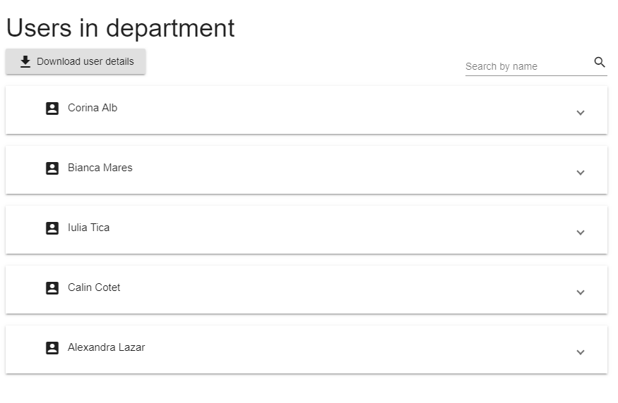
User management
Employees in department
You can see all the employees in the same department with the logged in user.
Can perform a search by name
Can download users’ detailed profile

Slide 11
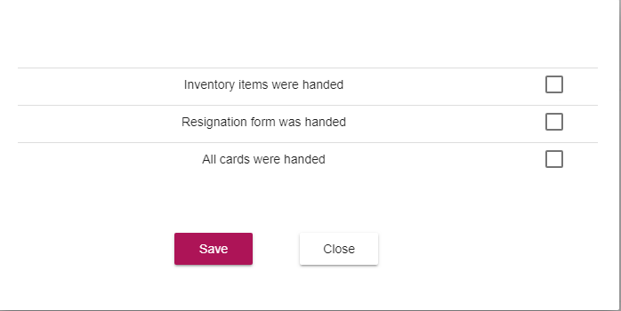
User management
How to remove users?
In order to remove users, you have to make sure that all the items on the leave check list are checked.

Slide 12

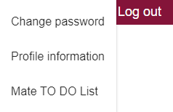
User menu
What is the user menu?
The user menu is the button next to Log out, under the name of the logged in user
In the menu, the user can change it’s password and can see a list of all the mate attributes

Slide 13
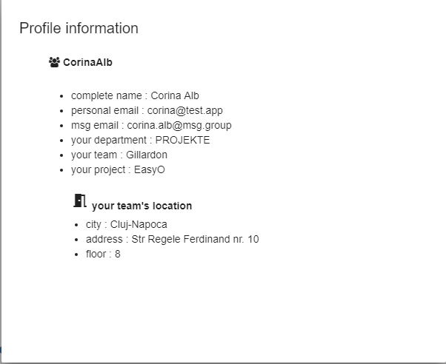
User menu
Profile Information

Slide 14
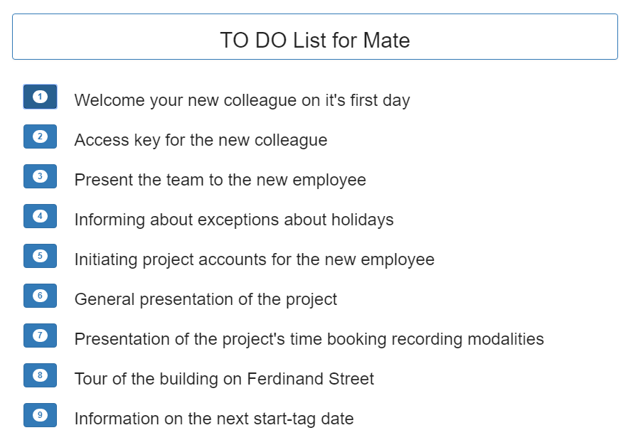
User menu
What is a Mate?
A mate is an employee that temporarily helps a new person in the company, until he/she integrates in the environment and learns the basic procedures.

Slide 15
Events
Why Events?
Any types of events happening inside .msg can be added in the application for everyone to enroll to them
Any user can see all the events
A user can see date and time, location and a short description of the event, all grouped in the same place

Slide 16
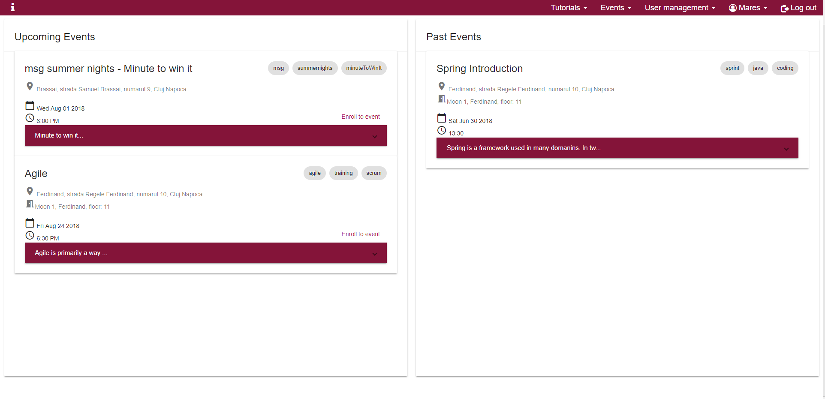
Events
Upcoming events & Past events
Event are grouped in upcoming & past events
A user can enroll only to an upcoming one

Slide 17
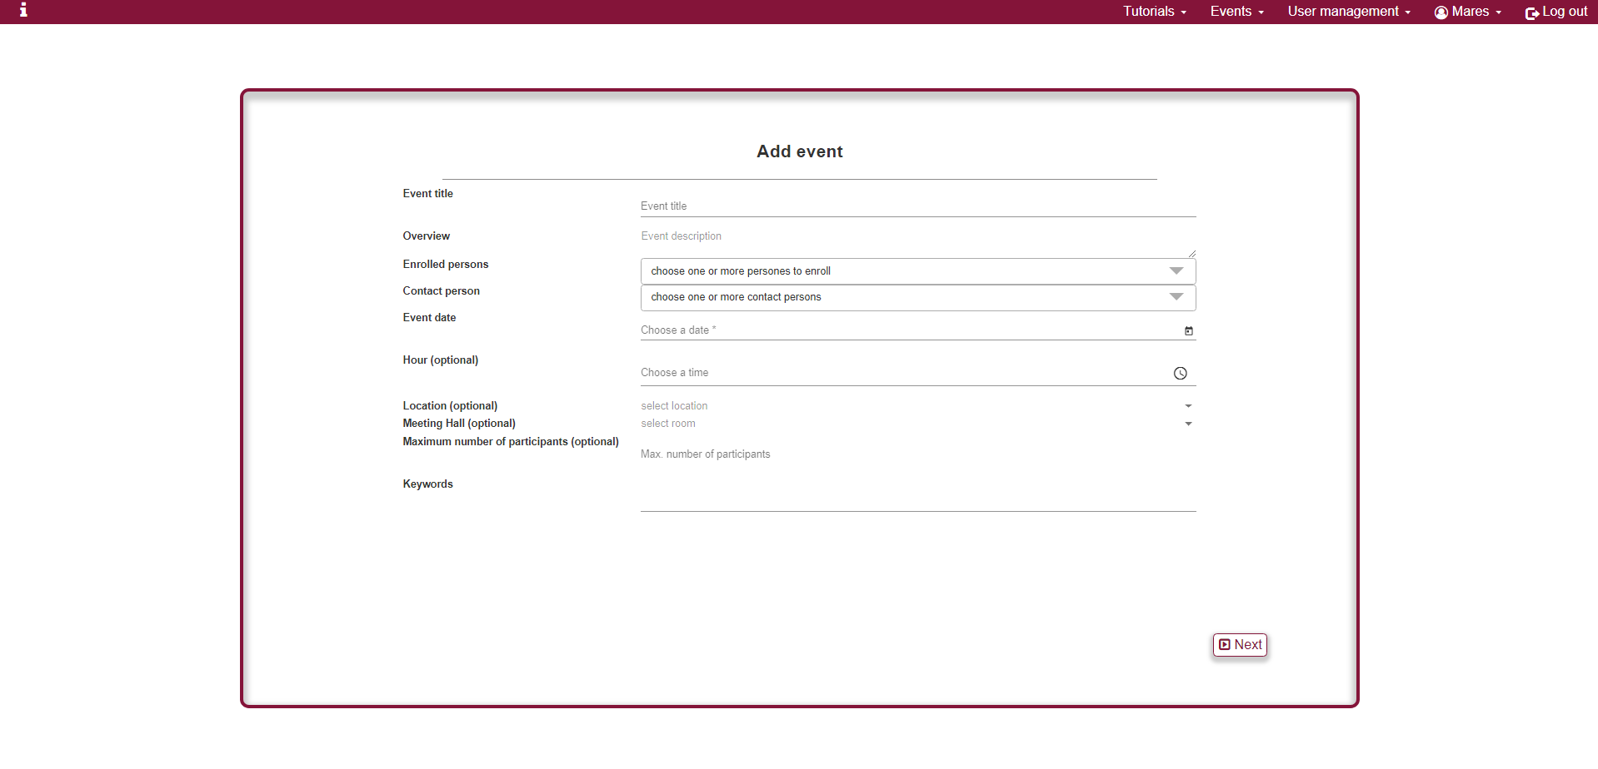
Events
Add new Event
New events can be added easily

Slide 18
Events
How to add an event?
To add a new event some information must be provided
Event title
A short description
Contact person
Event date
Keywords
Optionally can be provided
Location
Event time
Meeting hall
Maximum number of participants

Slide 19
Events
Features & Future functionalities
Features
Filter events by keywords
Enroll to event
The default number of attendees is the number of places in the room
Future improvements
View a list of all people enrolled to a event
Event update
Auto delete for old events
Optionally, a department can be selected: for example, msg Gillardon, and only the people in that department will see the new added event.
When adding an event, a manager will have to approve it.

Slide 20
Tutorials
Why tutorials?
Tutorials are useful for new employees
Were created based on the needs of the new employees
They explain how to use of the internal tools, applications and other useful information for setups.

Slide 21
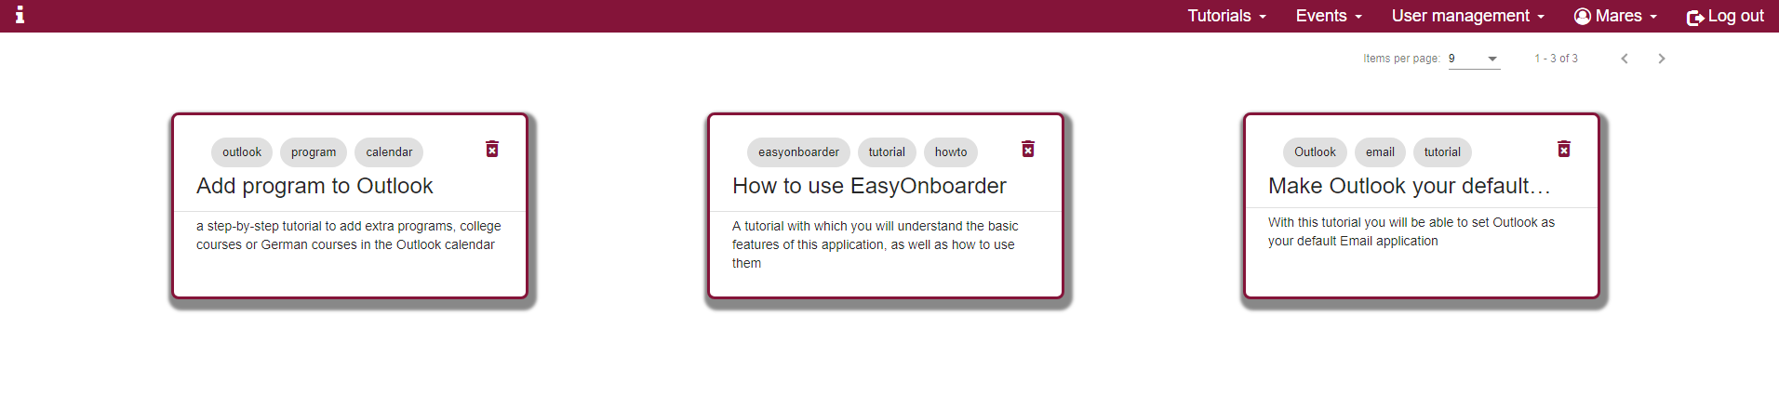
Tutorials
View Tutorials
Basic functionalities:
View
Filter based on keywords
Paginate tutorials – 9, 16, 36 or 99 items per page
Delete tutorial

Slide 22
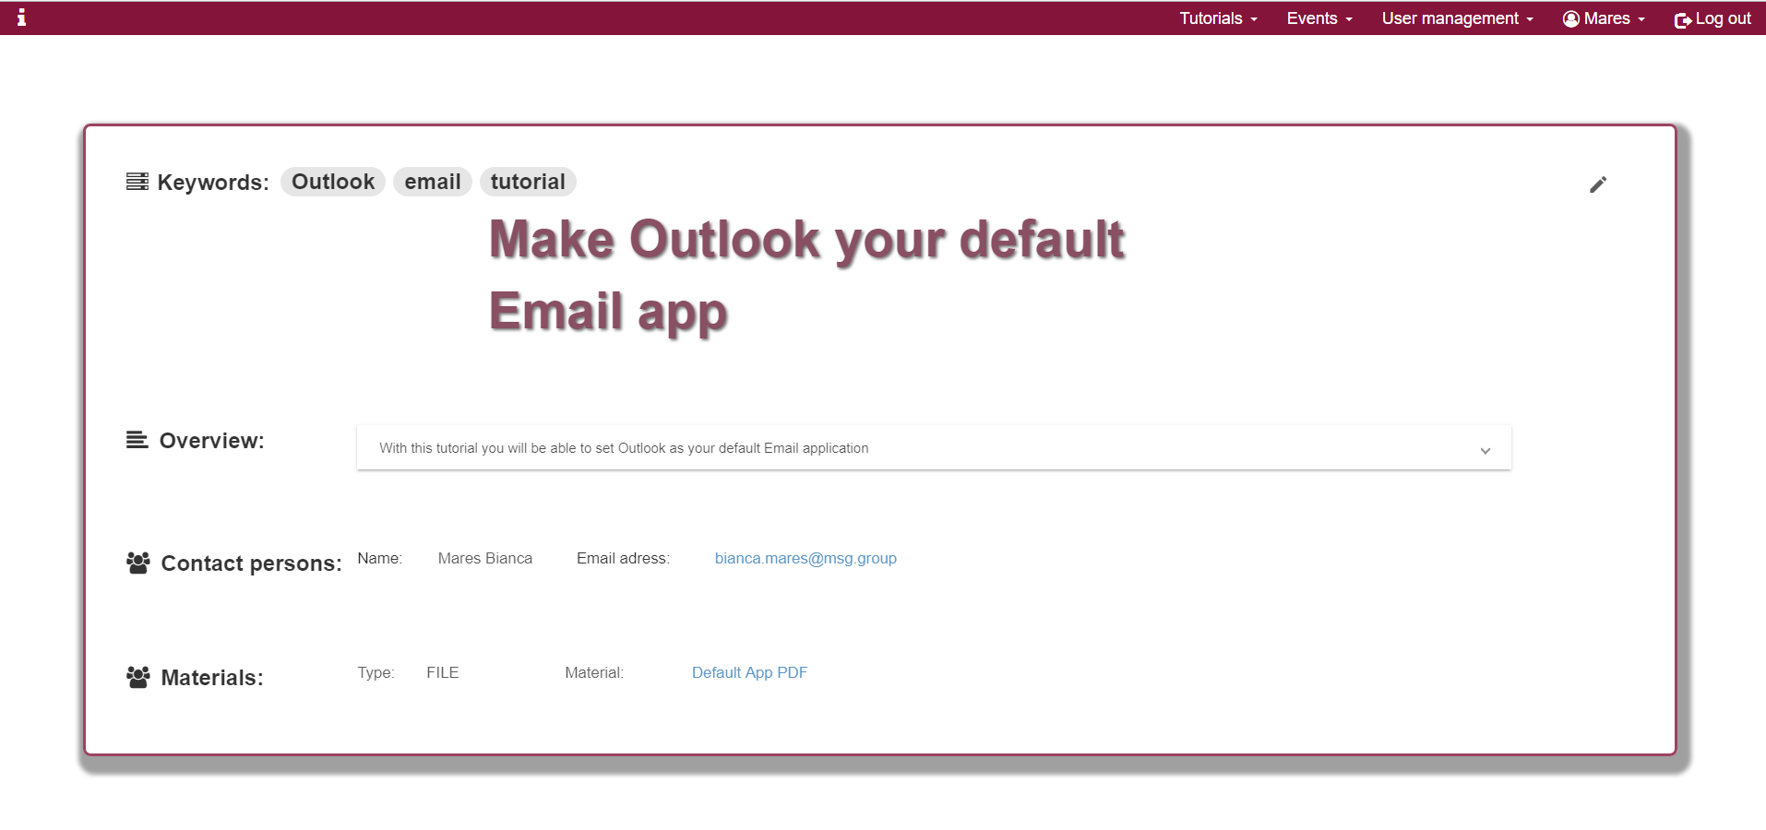
Tutorials
Tutorial details
After clicking on one of the tutorials a new page will be displayed containing additional functionalities

Slide 23
Tutorials
Tutorial details (2)
A tutorial has at least one contact person
By clicking the person’s email the Outlook application will be open, so this person is easier to contact if needed
Any material added can be found here, in the “Materials” section
A material can be a PDF tutorial or a useful web link
A user that is also the contact person for a specific tutorial can modify it by clicking the edit button

Slide 24
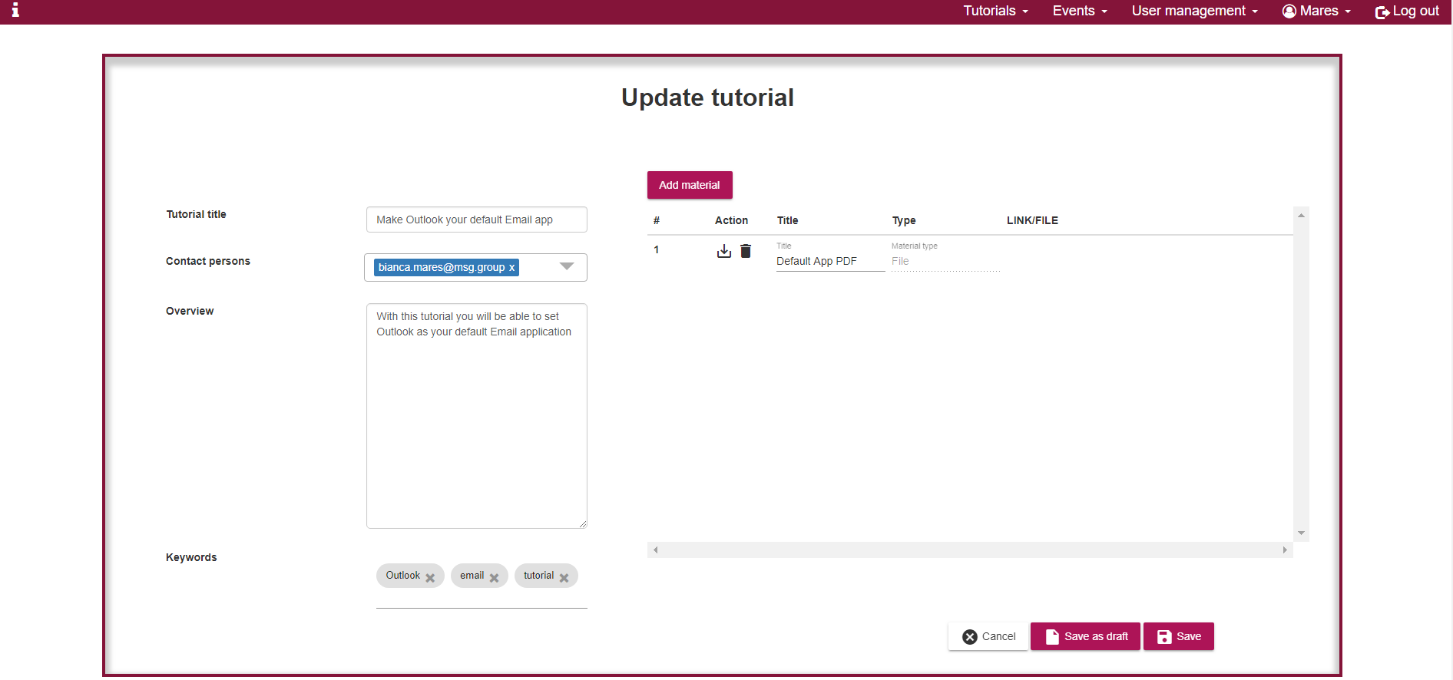
Tutorials
Edit tutorial
All fields can be changed when editing
The form is filled in with older information but any field can be replaced

Slide 25
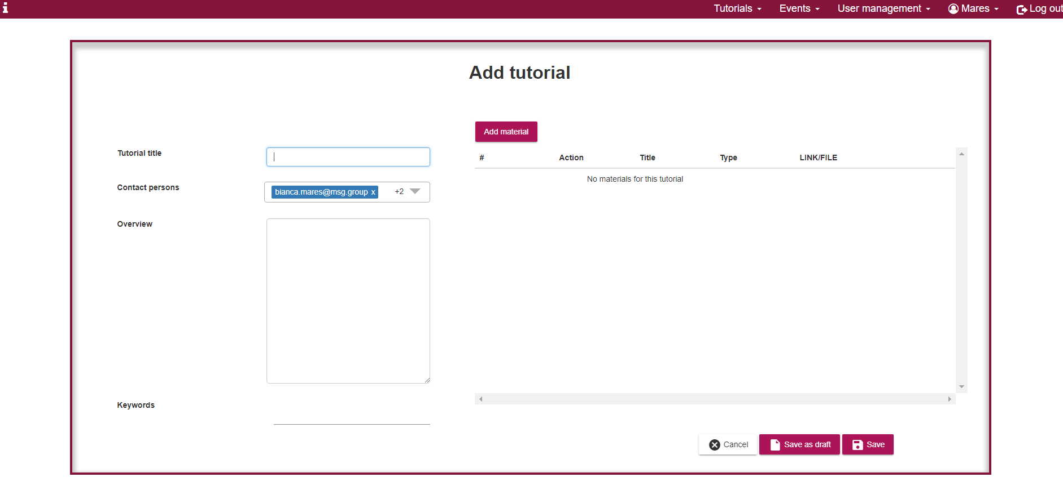
Tutorials
Add tutorial
To add a new tutorial a content manager or an admin must fill in some information about the tutorial: title, description, keywords and materials

Slide 26
Tutorials
Add tutorial (2) - Draft
Tutorials can be added as draft when not all information is known
Will not be visible to other users
A user can come back later to update a tutorial with draft status and publish it
To add as draft, a user must select the “save as draft” option from “add tutorial” page
If a person is contact person to a draft tutorial, then he/she can edit it
Two or more persons can work on a tutorial

Slide 27
Tutorials
Future functionalities
The manager of a team can assign certain tutorials to a specific user and can follow his/her progress.
Anybody can add a tutorial with the approval of the manager of the team the person is part of.
Search tutorials by title.

Slide 28
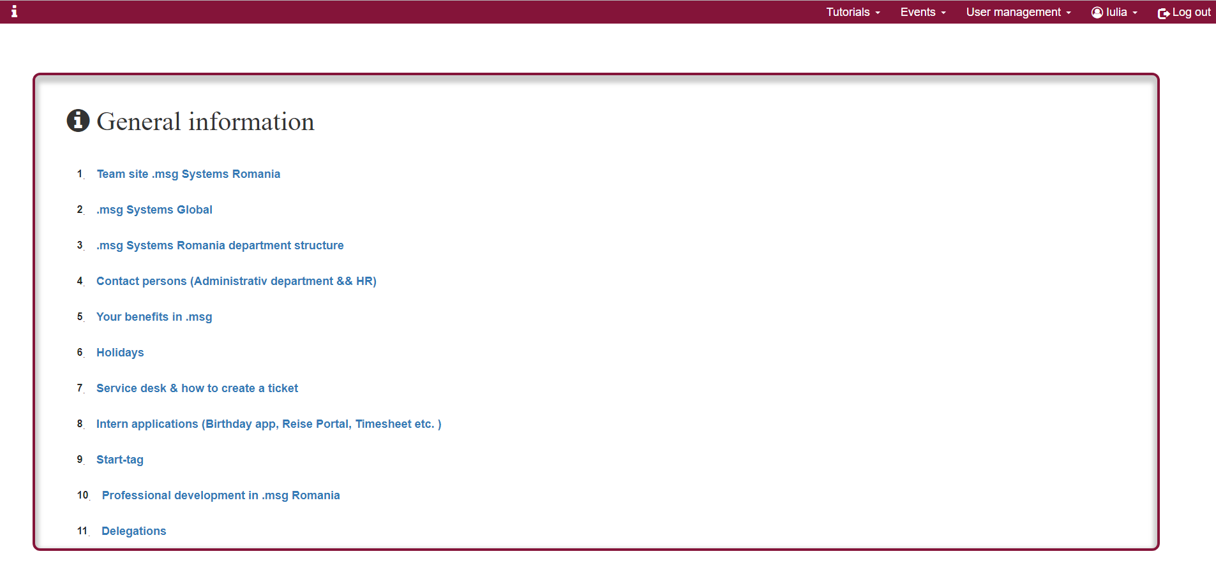
General information page
Why general information page?
There is a lot of useful information for the new comers on the .GURU .msg team site; however, this is often hard to find. This is why the general information page makes it easily available.

Slide 29
EasyOnboarder
Future functionalities
Right now, all the capabilities of the application are available to a super-user with the role of admin.
In the future, users with different roles will have different permissions.
A user that is a new employee will not have the same permissions as for example the manager of the team or the administrator of the system.
Security improvements
More use-cases will be implemented, according to the needs inside .msg
For this, we need as much input as possible from the people that will actually use the application
The user with the role of Mate will be able to keep track of the new employee or list of new employees to make sure everything is done.
For an event, if the location or the date changes, all the users already enrolled to that event will be notified.

Slide 30
Necessities.
Licenta Intellij
Suport pentru implementarea Spring Security
Spatiu stocare - Cloud
Git - repository privat
Code review (Angular + Java)
Task-uri bine definite

Slide 31
Danke schön!

